Slide 1
MoodSpo
By Anushka Jadhav

Slide 2
what is the project about?
This project is a customizable desktop application. It is meant for entertainment and aims to mix visual and audio aesthetics to provide a fun and cute result.

Slide 3
inspo
i’ve always wanted to make something aesthetically pleasing that blends audio and visuals together. i am a very frequent pinterest user, and i’m usually on it while listening to music. this was a sort of inspiration for me, except i wanted to make it more engaging, where instead of finding pictures the user can basically customize something by themselves, and based on their creation a song will be played.

Slide 4
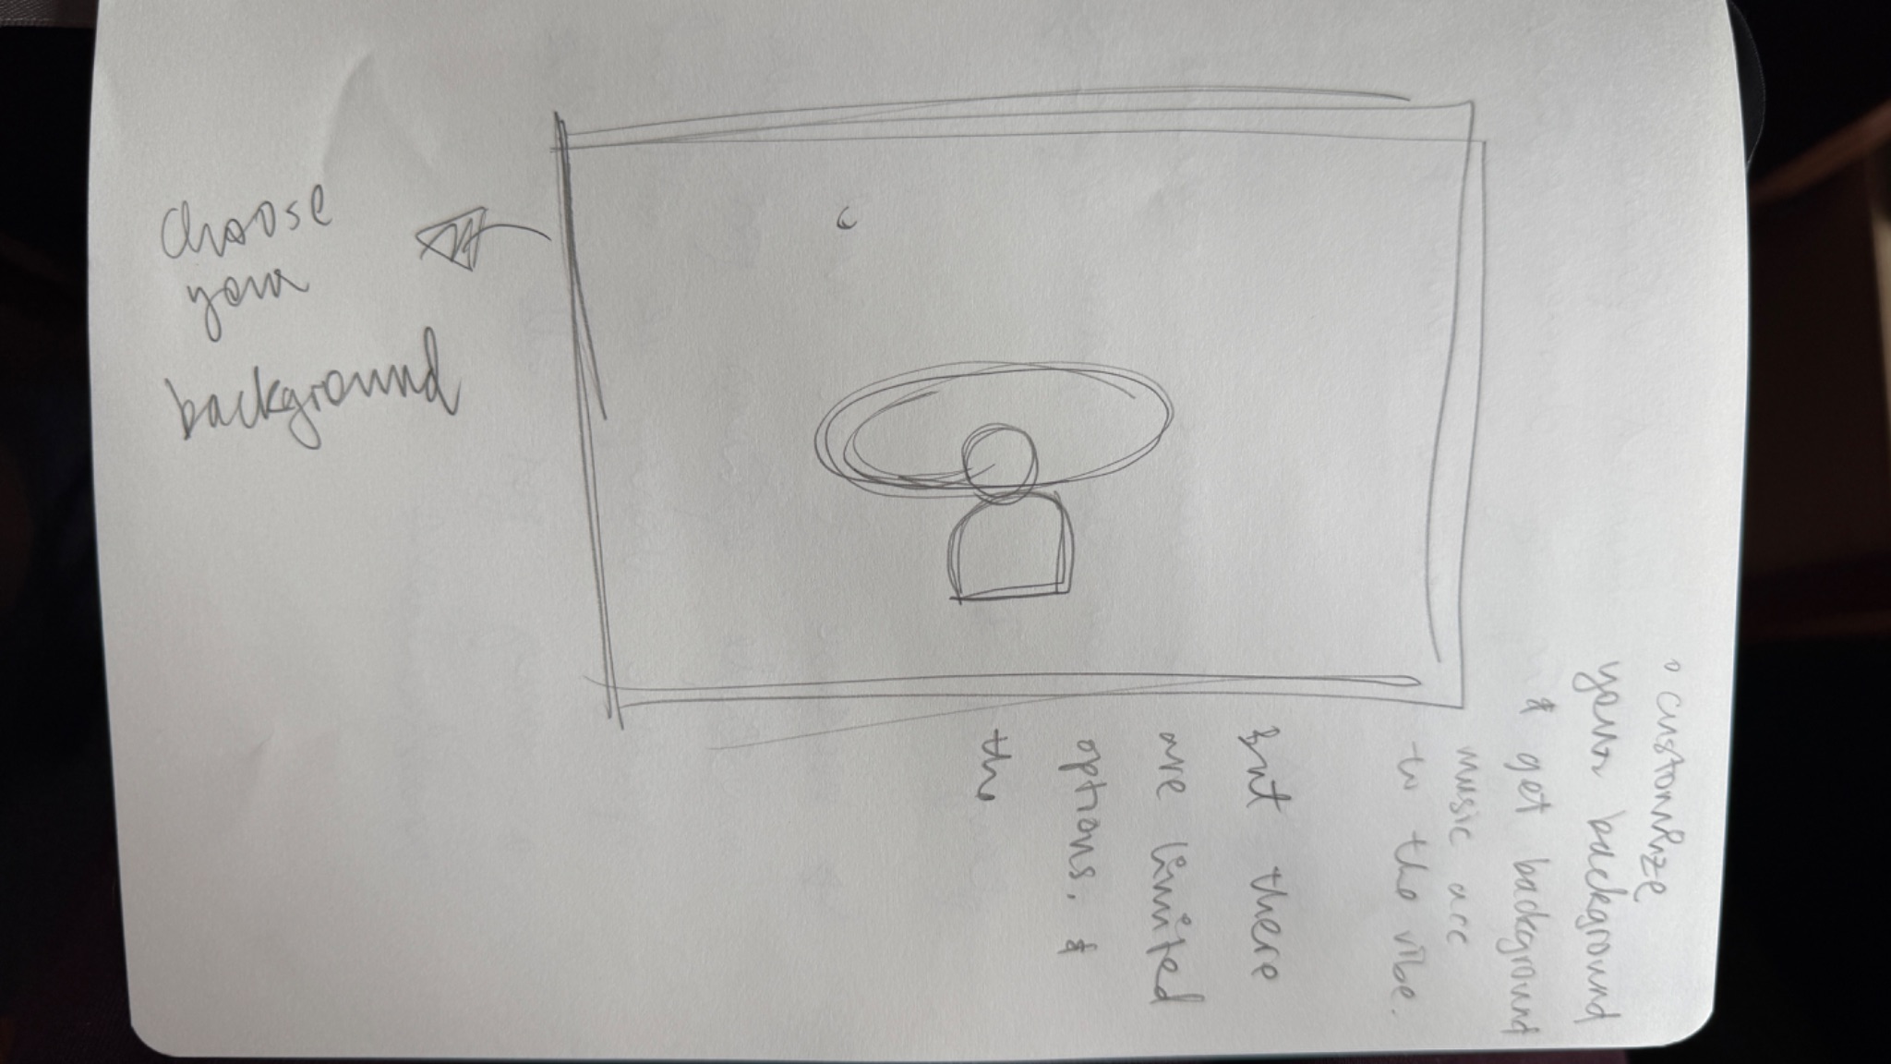
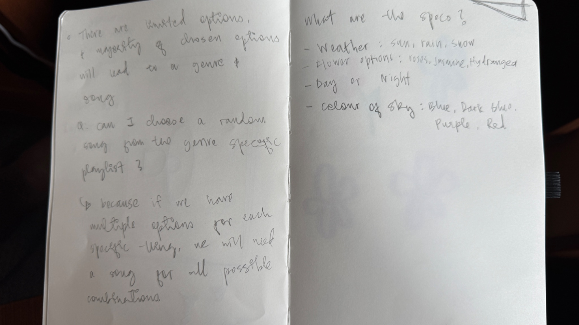
initial ideas
my first ever sketch and written idea!

Slide 5
i’ve used:
p5.js for the project.
audio recorded by me and uploaded into p5
the user’s job is to click any options they like and then press the play button, which will provide them with a song that has already been decided.

Slide 6
demo!

